Slide 1
A Holistic Approach to Managing Employee Benefit and Workers Compensation Costs
Presented By: Rubin Torrez
Benefit Advisory Manager
Date: June 13, 2019

Slide 2
Points of Discussion
Understanding the Silos
Establishing the Business Case
Best Practices: Blending Safety Wellness Strategies
Action Steps

Slide 3
Four Common Silos
HR Department
Benefit Related Expenses (Claims/Rates)
Absenteeism: Voluntary non-attendance at work, without a valid reason
CFO
Safety Responsibility, Workers’ Comp/RTW
Experience Mod
Productivity: Measure of efficiency of a person, machine, factory or a system
Employee
Benefits
Worksite
Wellness
Risk
Management
Safety
Committee
HR Department /Grassroots
Employee Engagement / Morale
Physical Health
Presenteeism: The measurable extent to which conditions adversely affect the productivity of individuals who choose to remain at work
Supervisors/Dept. Leads
Accident Avoidance
Training Opportunities

Slide 4




Four Common Silos
Employee Benefits
Risk Management
Worksite Wellness
Safety Committee

Slide 5
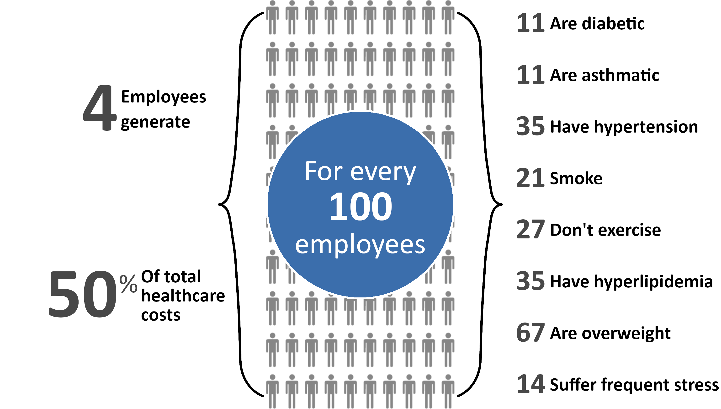
Why it Matters
Source: CDC, 2016-2018; United Health Foundation, 2017

Slide 6
Building the Business Case
Poor health costs the U.S. economy $576 billion a year
$227 billion from lost productivity, absenteeism, and presenteeism
$117 billion from absence due to illness, workers’ compensation, and disability
$232 billion from medical treatment and pharmacy related costs
Medical care inflates at a rate 50% faster than total inflation
Source: BLS, 2019; Kocak, 2018

Slide 7



Why Is Healthcare So Expensive?
Increasing severity – decreasing frequency
Attempts to maximize income by some
Trends in our society:
Aging Population
Obesity
Cultural shifts
Mental Health

Slide 8
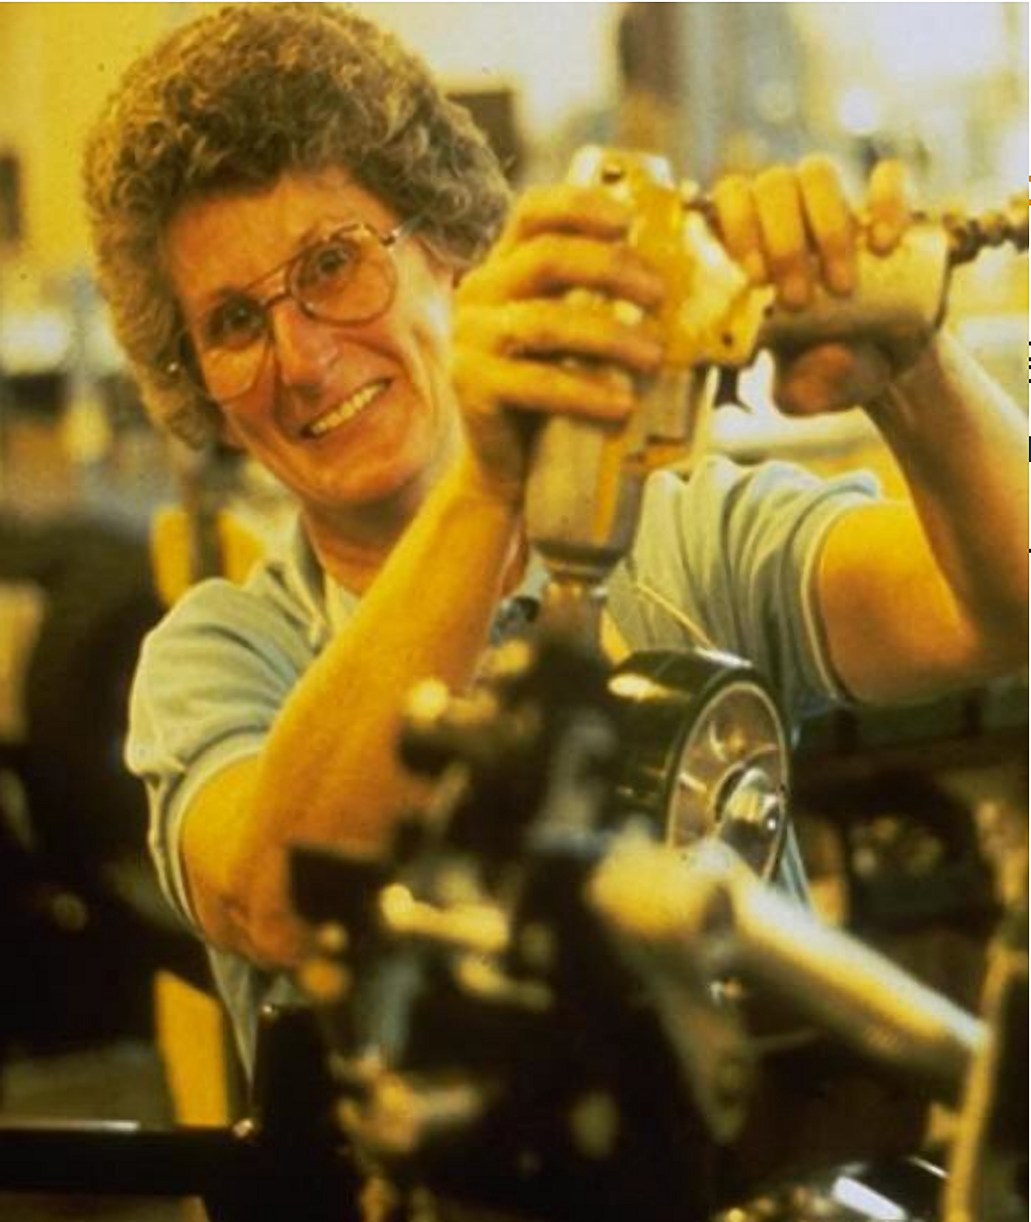

An Aging Workforce
Our workforce is quickly aging
As of 2018, there were 162,075,000 people in the civilian labor force.
Millennials/Generation Z (1977-Present): 51%
Generation X (1965-1976): 26%
Silent Generation/Baby Boomers (1964 or earlier): 23%
Source: BLS, 2019

Slide 9
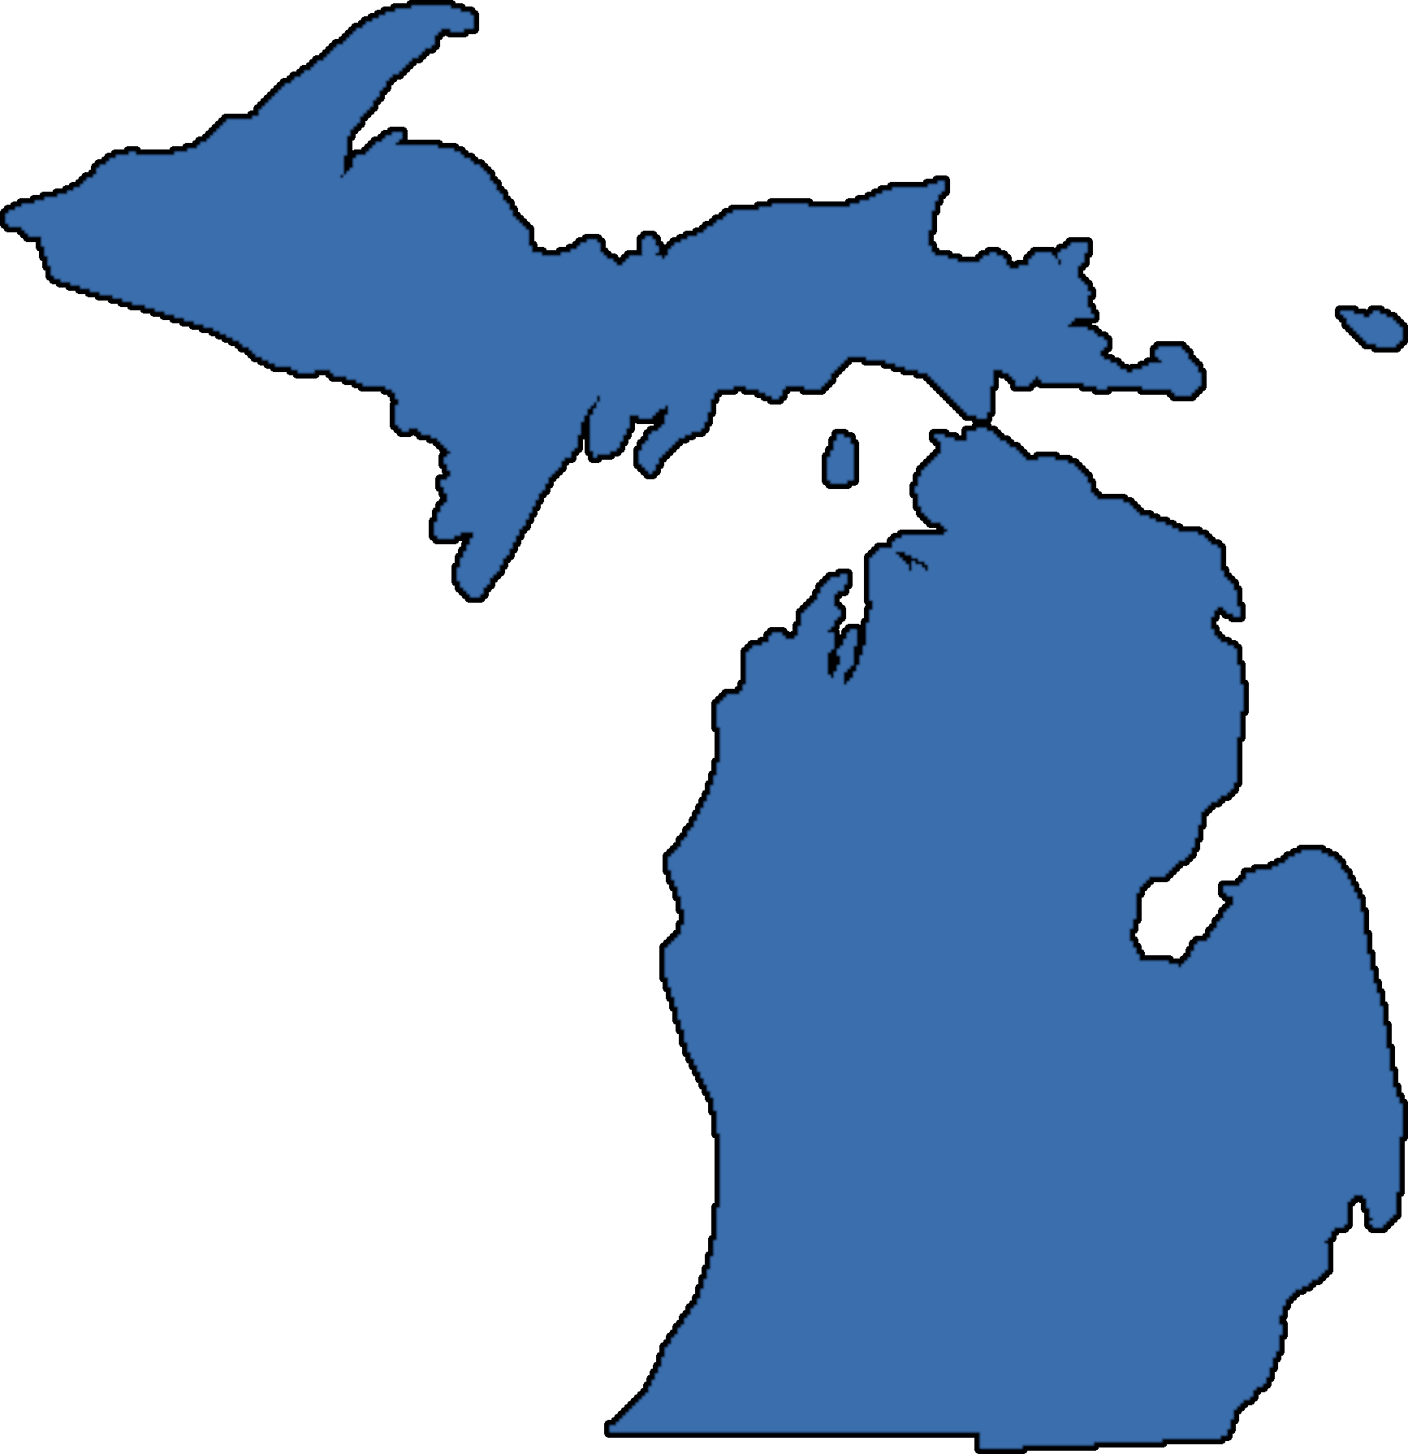
An Aging Workforce – Michigan
Ranks 12th in percentage of residents age 65+ nationwide
Average lifespan for a Michigander 78
- 75 for Men
- 81 for Women
Residents age 60 and older make up almost a quarter of the state’s population
10,000 Michigan Residents will reach retirement age each month until 2020 – and then the numbers will accelerate.
Source: Blue Cross Blue Shield of Michigan, 2019

Slide 10
Common Age-related Injuries
Changes with Age
Type of Injury
Loss of strength
Loss of muscular flexibility
Diminished postural steadiness
Reduced grip strength
Reduced balance
Reduced nervous system responses
Reduced cardiovascular capacity
Reduced visual capacity
Strains, sprains; tendonitis
Strains, sprains; falls
Slips, trips, falls; fractures, sprains, strains
Rep. motion disease; inflammation; CPS
Slips, trips, falls; fractures, sprains, strains
Decreased reaction times, struck by objects
Greater risk for heart attack, stroke
Greater exposure to hazards, falls

Slide 11

Predictions for Future Workforce
Will retire later
Will be dependent on dual incomes and entitlement
Low claim frequency
High claim severity
Increased falls
Longer healing times
More severe musculoskeletal disorders

Slide 12
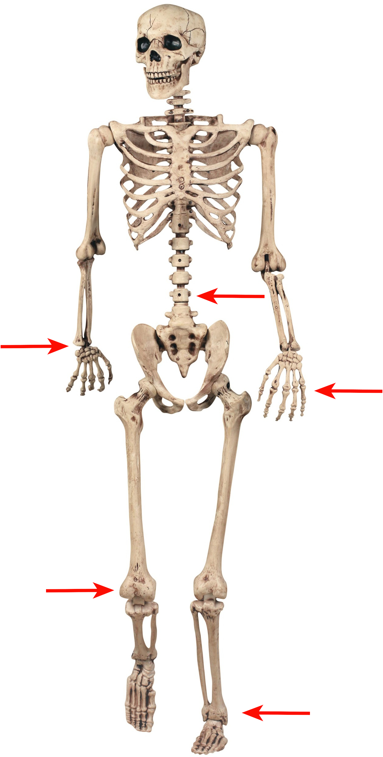
Cost of Obesity
Obesity contributes largely to the four conditions with the greatest annualized costs
Diabetes
Lower back and neck pain
Hypertension
Hyperlipidemia
Claims most strongly associated with elevated Body Mass Index (BMI):
Lower extremity, wrist, hand, or back, pain/inflammation; sprain or strain; contusion/bruise; falls/slips; lifting; exertion
Source: Truls Østbye, MD, PhD, 2007
Notes:
Transition first bullet point and then everything else.
New picture…this one is a little creepy

Slide 13
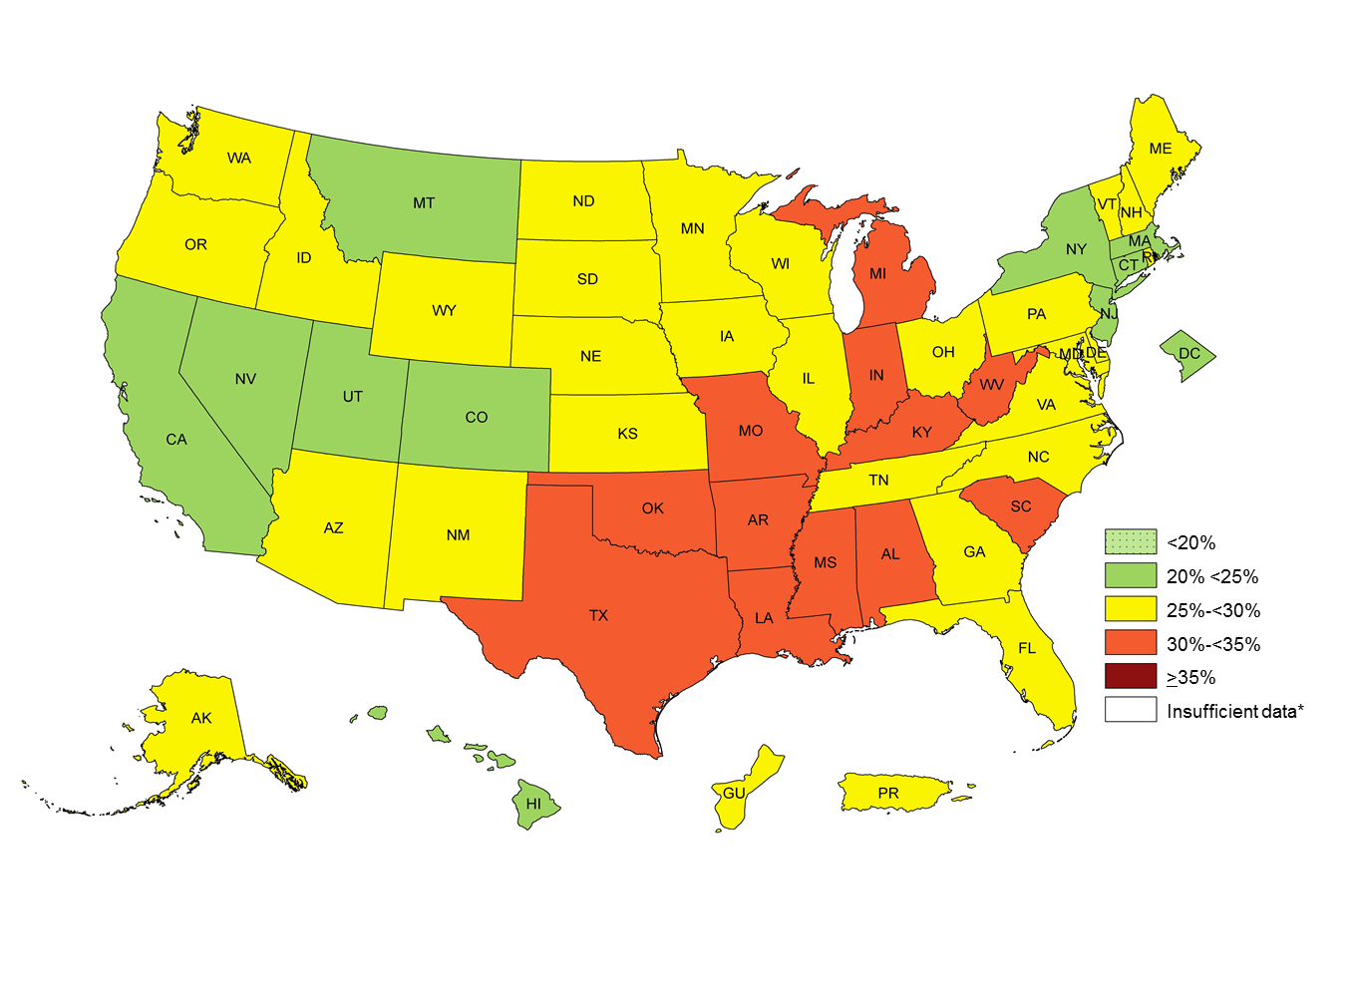

Prevalence of Self-reported Obesity Among U.S. Adults by State and Territory, BRFSS, 2011
Prevalence estimates reflect BRFSS methodological changes started in 2011. These estimates should not be compared to prevalence estimates before 2011.
*Sample size <50 or the relative standard error (dividing the standard error by the prevalence) ≥ 30%.

Slide 14
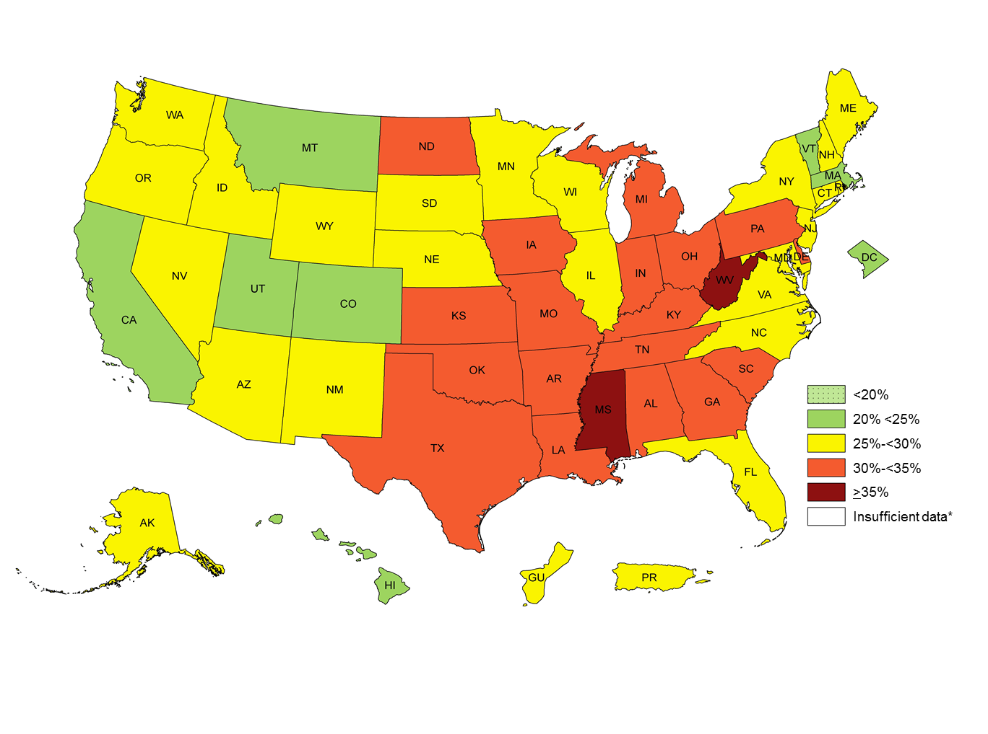
Prevalence of Self-reported Obesity Among U.S. Adults by State and Territory, BRFSS, 2013
Prevalence estimates reflect BRFSS methodological changes started in 2011. These estimates should not be compared to prevalence estimates before 2011.
*Sample size <50 or the relative standard error (dividing the standard error by the prevalence) ≥ 30%.

Slide 15
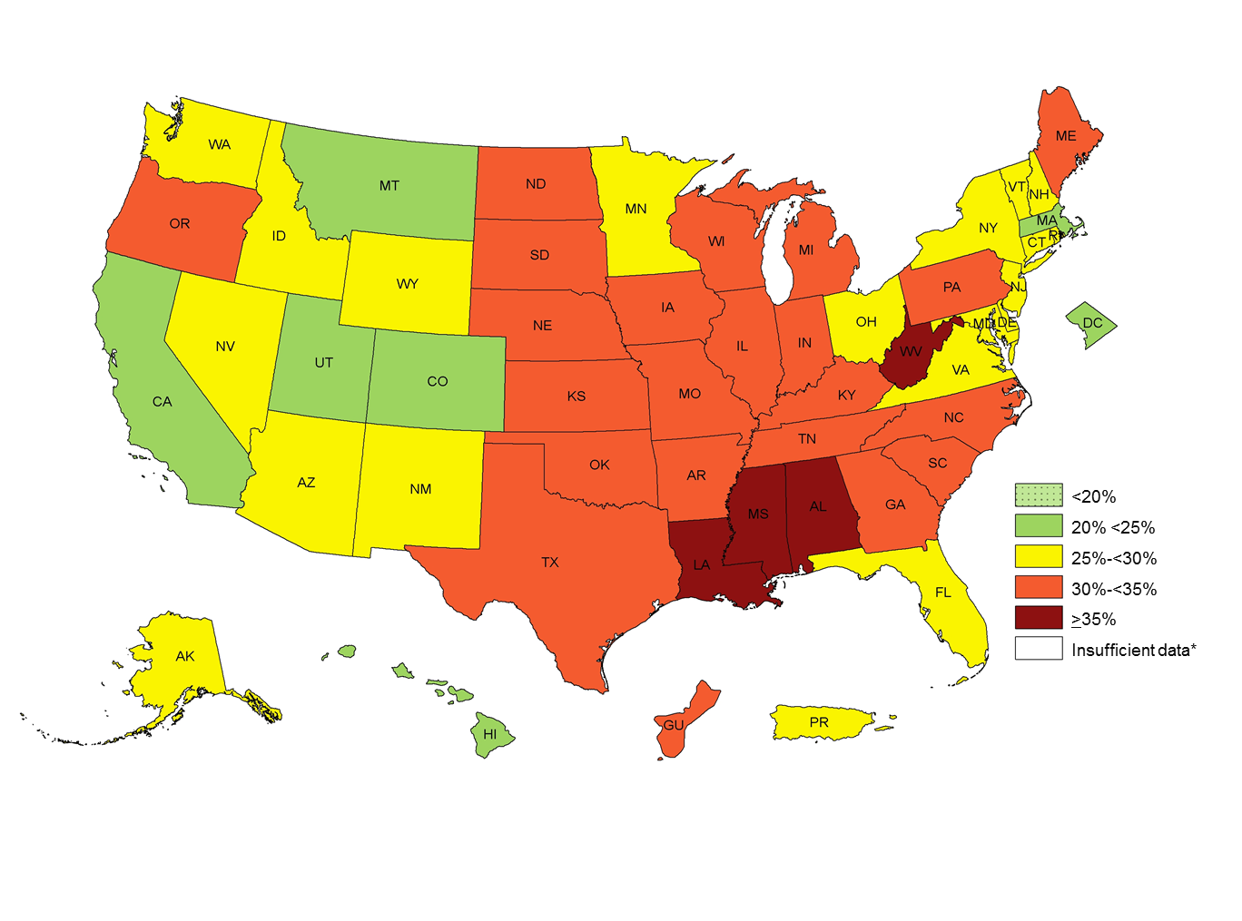
Prevalence of Self-reported Obesity Among U.S. Adults by State and Territory, BRFSS, 2015
Prevalence estimates reflect BRFSS methodological changes started in 2011. These estimates should not be compared to prevalence estimates before 2011.
*Sample size <50 or the relative standard error (dividing the standard error by the prevalence) ≥ 30%.

Slide 16
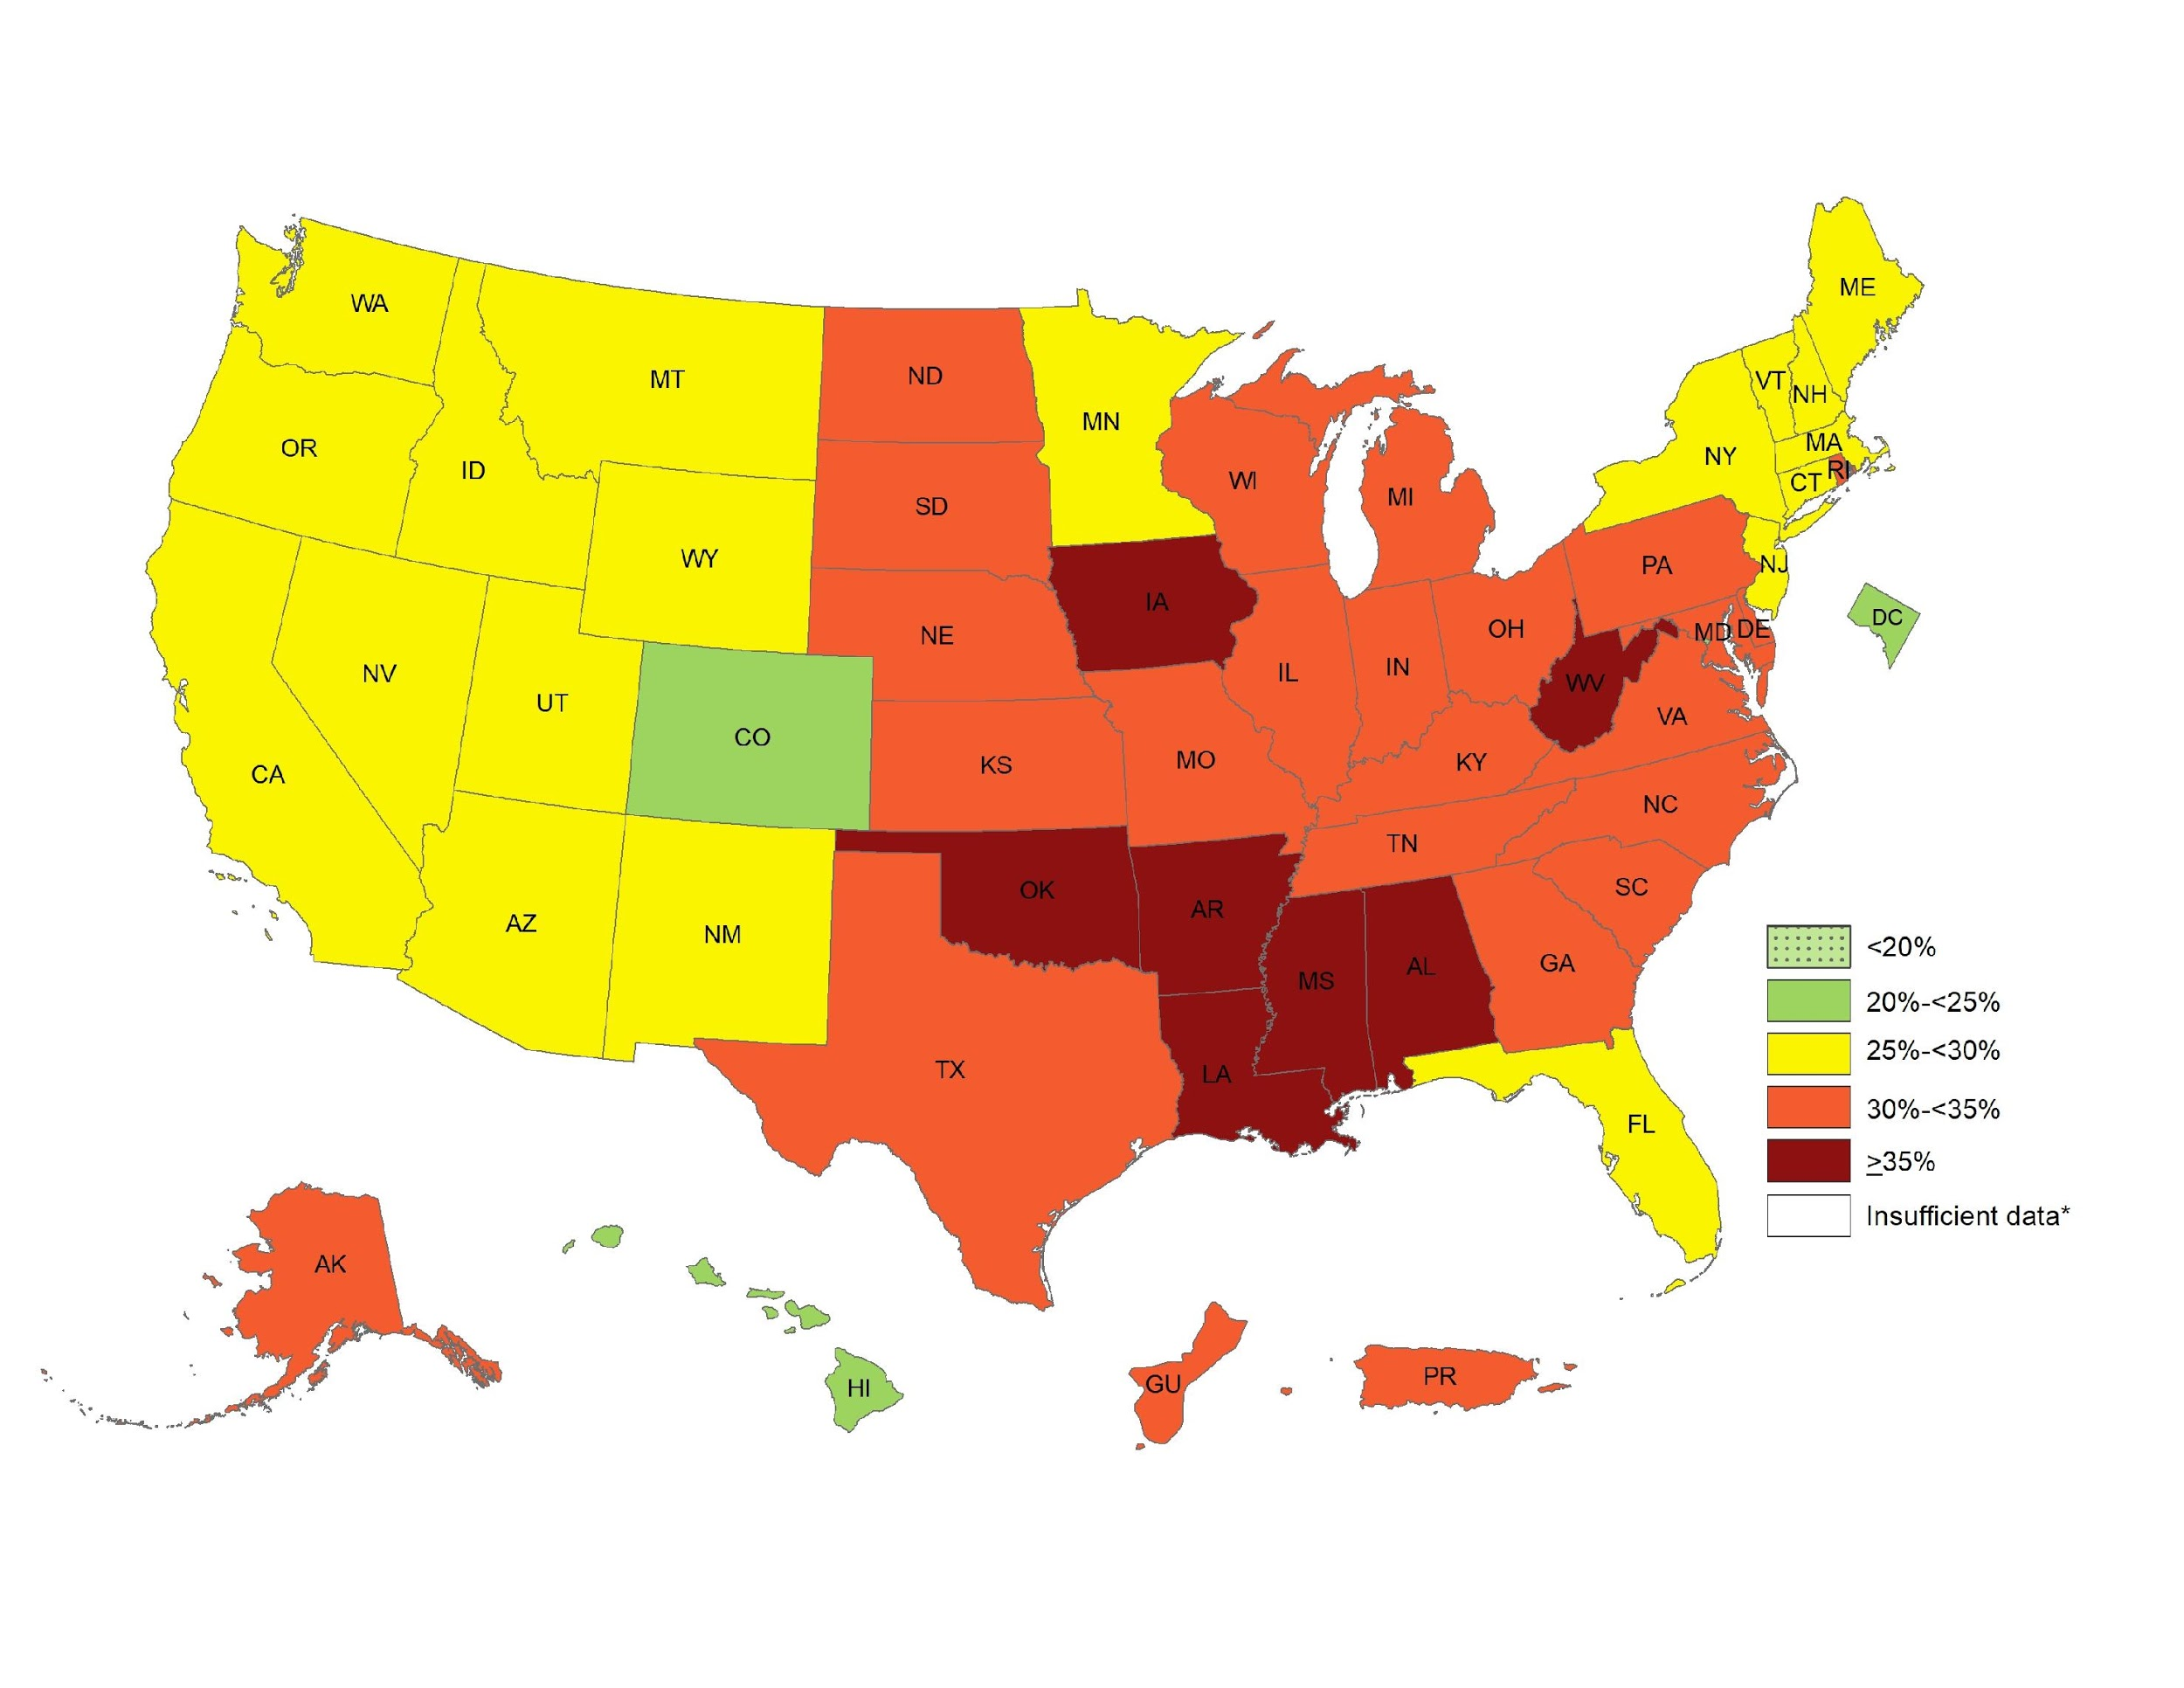
Prevalence of Self-reported Obesity Among U.S. Adults by State and Territory, BRFSS, 2017
Prevalence estimates reflect BRFSS methodological changes started in 2011. These estimates should not be compared to prevalence estimates before 2011.
*Sample size <50 or the relative standard error (dividing the standard error by the prevalence) ≥ 30%.

Slide 17
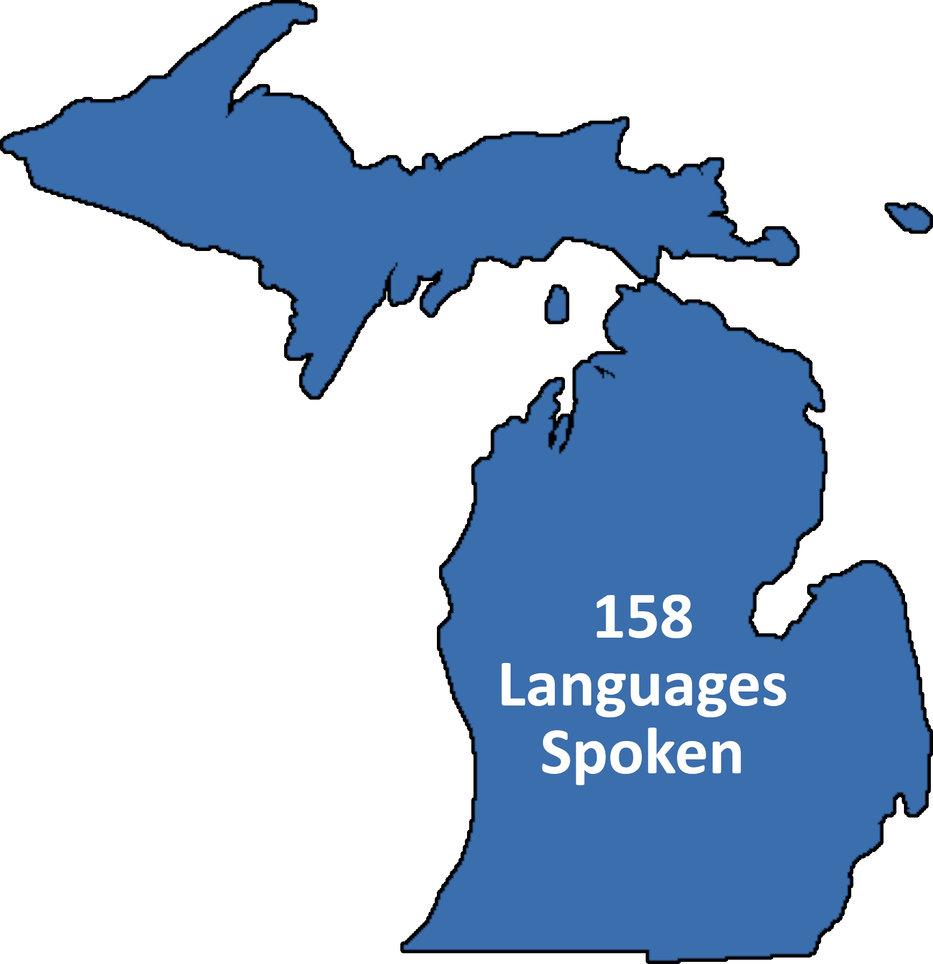
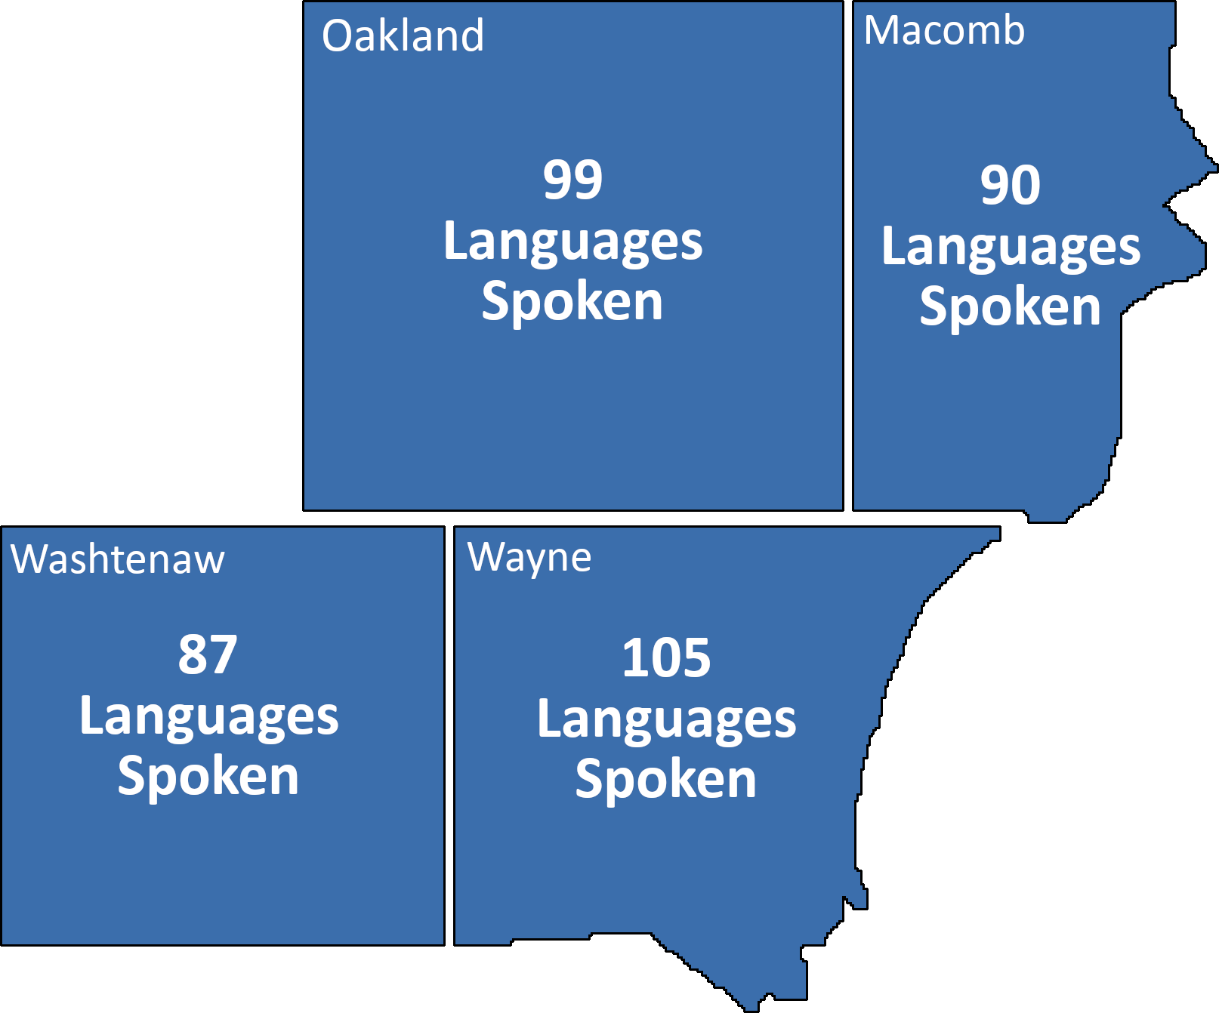
Cultural and Linguistic Changes
Communication channels are vast…and so are the language barriers
13-14%
of Population
9% of Population
Source: US Census Bureau, 2013
Notes:
Split the slide into two areas (one click, two clicks)

Slide 18
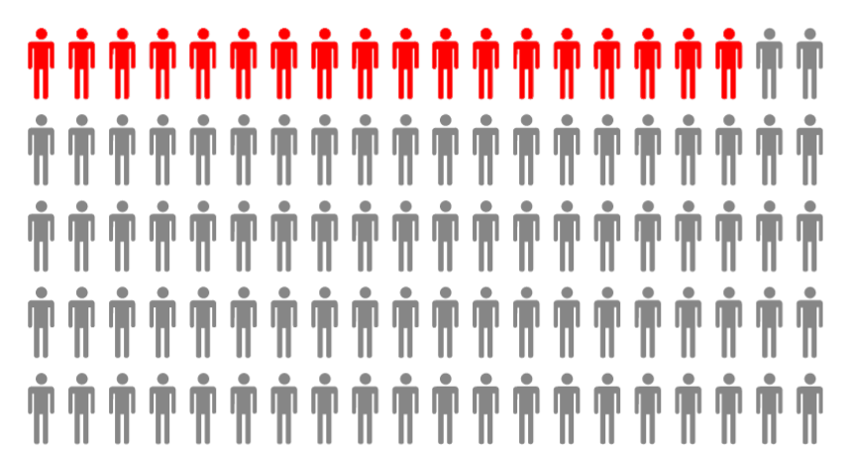
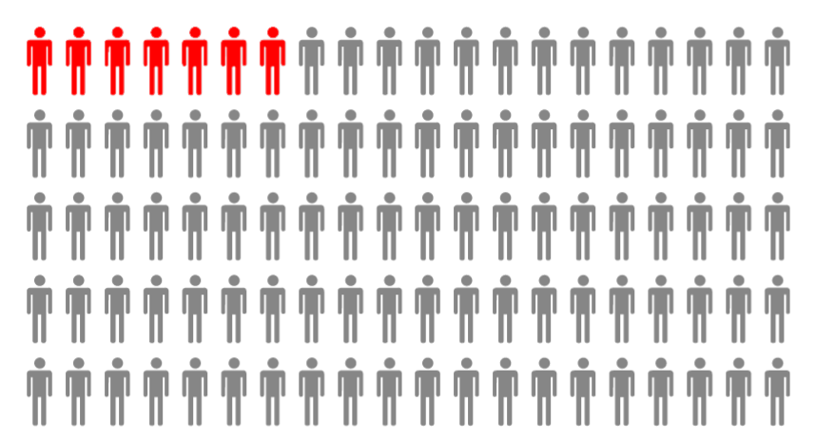
Costs of Poor Mental Health
Depressive Disorders have the fifth greatest annualized cost (after the four associated with obesity) per year
Each case costs $217/year in medical expenses
Anxiety disorders are the most common mental illness in the U.S affecting ~18% of population
Leading cause of disability in the U.S. among ages 15-44 impacting ~7% of population
Mental health disorders are often highly treatable, yet fewer than half of those affected receive treatment
Source: CDC, 2016; Dieleman, 2018; NIMH, 2019; Our World in Data, 2017
Notes:
Area that states Depressive Disorders comes in 1st, then second click everything else.
Mental health disorders are often highly treatable, yet fewer than half of those affected receive treatment

Slide 19
Work Related Stress
Increased risk of stress-induced health concerns
Psychological Symptoms | Physical Symptoms | Behavioral Symptoms
Depression | Fatigue | Increase in Absenteeism/ Presenteeism
Anxiety | Muscular Tension | Aggression
Discouragement | Headaches | Diminishing Creativity and Initiative
Cognitive Difficulties (Unable to cope or concentrate) | Sleep Difficulties | Drop in Work Performance
Source: Better Health - last updated June, 2012
Notes:
Three clicks…Psych, Physical and then Behavioral

Slide 20
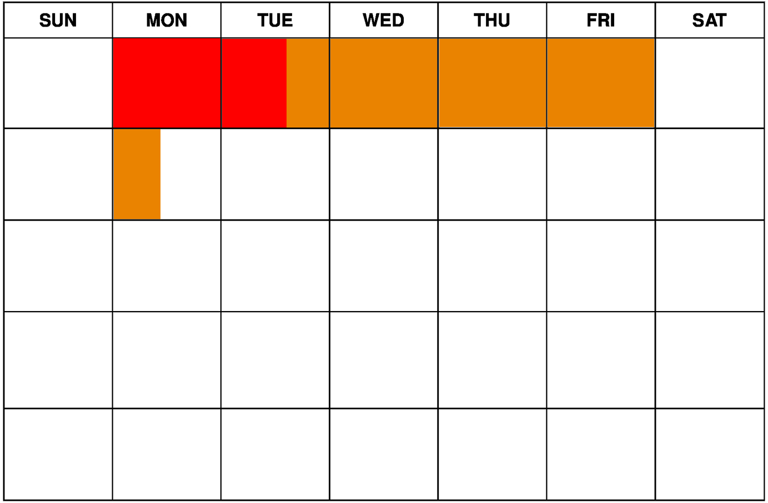
Costs of Poor Mental Health
Patients with depression miss an average of 1.6 workdays and suffer 3.8 days of reduced productivity each month
This leads to $945/year of costs of lost work for each case
Source: CDC, 2016; Dieleman, 2018; NIMH, 2019

Slide 21



Why Have Wellness and WC Not Mixed
Wellness typically focuses on employee benefits only
Some companies keep WC in risk management and employee benefits with HR…wellness message not shared
Carriers slow to make correlation
Many employers haven’t seen correlation
Notes:
Two clicks – Theme
Right Answer Down on White Board, then show content.

Slide 22
Impact on Cost Measures
Outcome Measure | Low Risk (N= 671) | Medium Risk (N= 504) | High Risk (N= 396)
Short-term Disability | $120 | $216 | $338
Workers Compensation | $228 | $244 | $496
Absence | $245 | $341 | $527
Medical & Pharmacy | $1,158 | $1,487 | $3,696
Total | $1,751 | $2,288 | $5,052
Source: Wright, Beard, Edington, 2002

Slide 23
Impact on Cost Measures
Outcome Measure | Low Risk (N= 671) | Medium Risk (N= 504) | High Risk (N= 396)
Short-term Disability | $193 | $347 | $544
Workers Compensation | $367 | $392 | $798
Absence | $394 | $548 | $847
Medical & Pharmacy | $1,862 | $2,391 | $5,943
Total | $2,816 | $3,679 | $8,132
Source: Wright, Beard, Edington, 2002 (Corrected to 2019 based on standard increases compensation costs by BLS, 2019)

Slide 24


Worksite Safety and Wellness
Implications for employers with employees at low risk
Healthier, more productive workforce
Lower direct and indirect health related costs
Greater health/independence
Greater energy/vitality
Increased life and job satisfaction

Slide 25
Management’s Perspective
National Health & Productivity Survey
68% have some type of wellness program.
61% identified employees’ health habits as the primary challenge in controlling health care costs.
54% are implementing a high deductible health plan in an effort to address rising health care costs.
64% provide employees with tools and resources to become better consumers.
53% said that their organization was effective at leveraging their health insurance carriers to drive health and productivity.
56% said that their organization was effective at leveraging their insurance broker or consultant to drive health and productivity.

Slide 26
Management’s Perspective
National Health and Productivity Survey | National Health and Productivity Survey Results | Audience Survey Results
Do you offer some type of wellness Program? | 68%
Are your employees’ health habits a primary challenge in controlling health care costs? | 61%
Have you implemented a high deductible health plan in an effort to address rising health care costs? | 54%
Do you provide your employees tools and resources to become better healthcare consumers? | 64%
Is the organization effectively leveraging their health insurance carriers to drive health and productivity? | 53%
Is your organization effectively leveraging their insurance broker or consultant t drive health and productivity? | 56%
Notes:
Can we transition row by row?

Slide 27
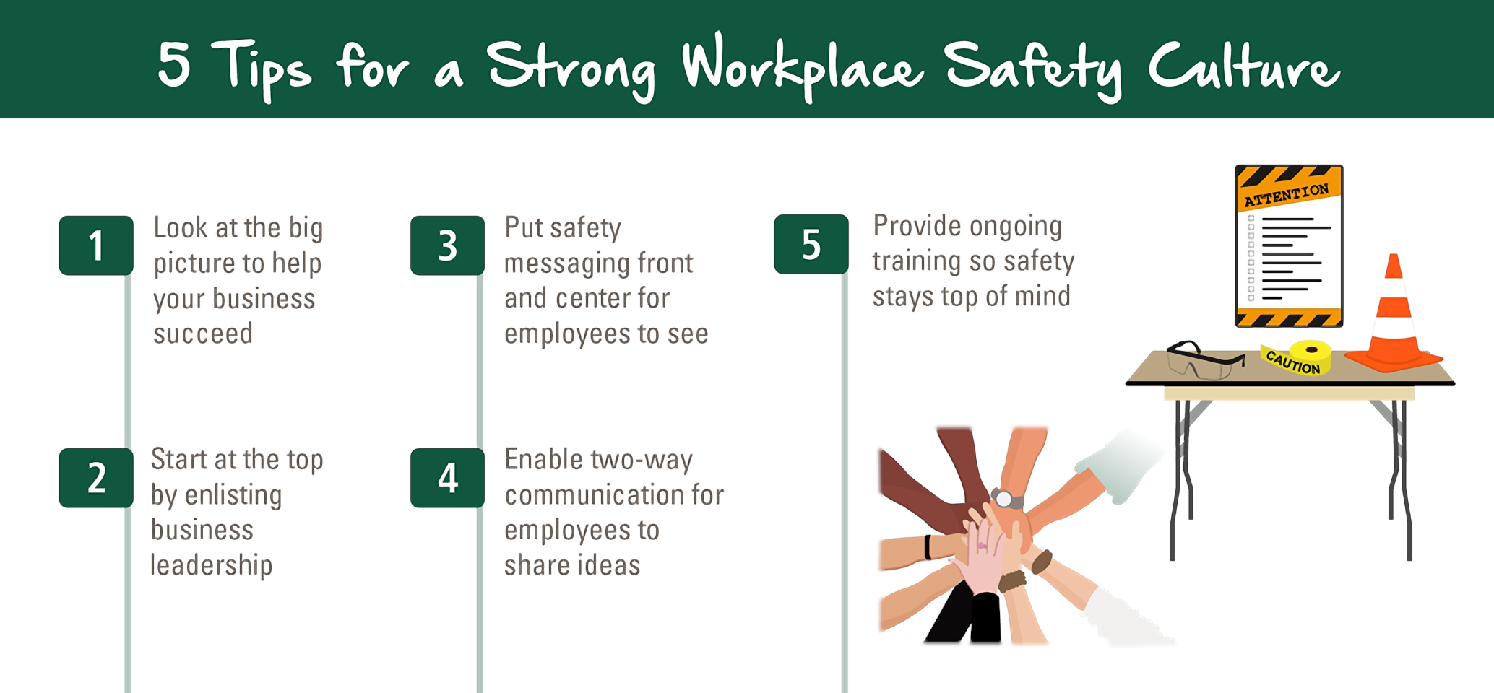
Create a Safety/Wellness Committee
Make safety and health a core organizational value
Establish safety and health goals and objectives
Set program expectations and responsibilities
Provide adequate resources and support for the program

Slide 28
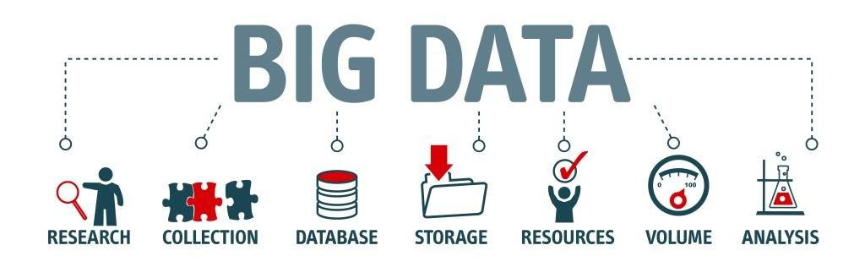
Metrics– Know Your Numbers
Collect data from:
Health screenings
Health risk appraisals
Health insurance claims
Workers’ compensation records
Absenteeism rates
Employee satisfaction surveys / Cultural audits

Slide 29
Metrics– Know Your Numbers

Slide 30
Metrics– Know Your Numbers
Source: CDC, 2016-2018; United Health Foundation, 2017

Slide 31
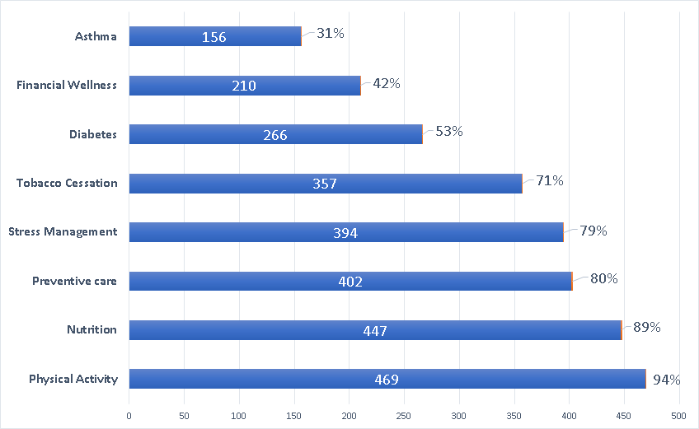
What Are Employers Doing?
National Health & Productivity Survey: Number of Organizations Addressing Topics in Wellness Programs (n=500)
Notes:
We need to get this slide ready for survey results just like the other slide.

Slide 32
What Are Employers Doing?
A study by U.S. Corporate Wellness reports that the average results of an employee wellness plan include:
Drop in workers’ compensation and disability claims by as much as 3%
Decrease in short-term sick leave by as much as 32%
Savings of between $3 and $6 for every $1 invested
Source: US Corporate Wellness, 2010

Slide 33
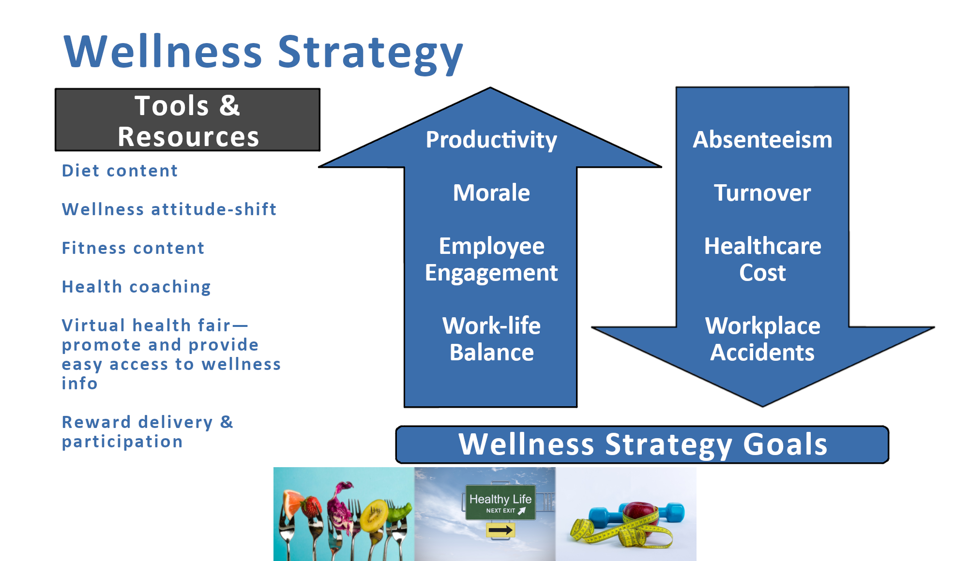
Wellness Strategy
Absenteeism
Turnover
Healthcare
Cost
Workplace Accidents

Slide 34

Building a Business Plan
Research
Determine the purpose of your plan
Create a company profile
Document all aspects of your business
Have a strategic marketing plan in place
Make it adaptable based on your audience
Explain why you care

Slide 35

Summary
The time is now to breakdown the silos to mitigate HC Risk
Healthy people cost less, are more productive and add more to the bottom line!

Slide 36

Questions

Slide 37
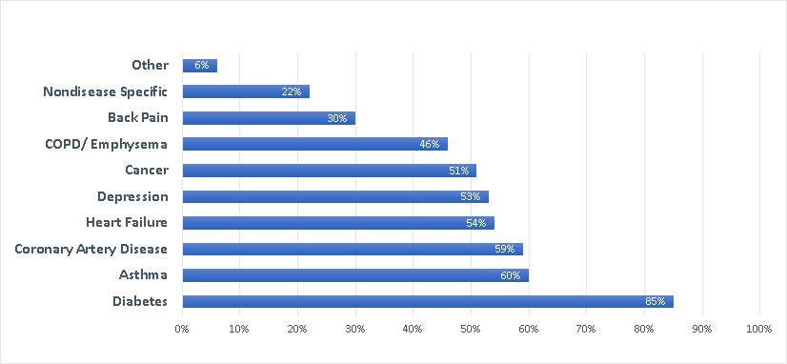
Percentage Offering Programs for Special Chronic Conditions
Source: RAND Employer Survey, 2012

Slide 38

WELCOA’s Seven Benchmarks
Committed and Aligned Leadership
Collaboration in support of Wellness
Collecting meaningful data to evolve a strategy
Crafting an operating plan
Choosing initiatives that support employees
Cultivate supportive health promoting environments, policies, and practices
Conduct evaluation, communicate, celebrate, and iterate

Slide 39
Measuring Outcomes
What gets measured, gets done:
Cost of Service
Percentage of technical support tickets closed within a specific time
Percentage of satisfied users
Make Sure:
Your team understands Key Performance Indicators (KPI)
Determine what indicators are important
Express KPI’s formula as: cost/searches= cost per search
Create a dashboard
Discuss the results
Analyze KPI

